Slide 1
UNMANNED AERIAL VEHICLE
PREPARED BY: MUHAMMAD GHAZALI BIN RAMLY

Slide 2
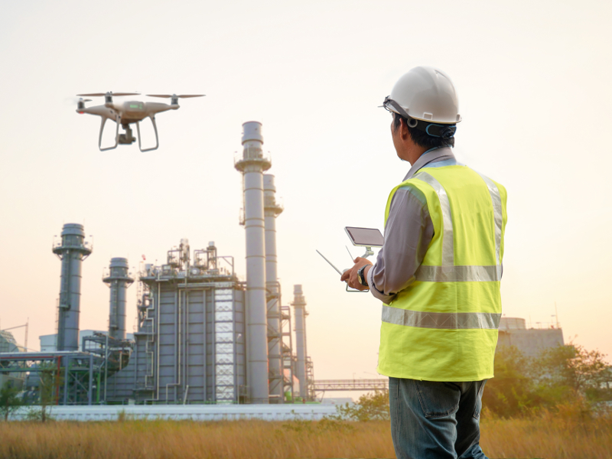
OIL AND GAS INSPECTION DRONE

Slide 3
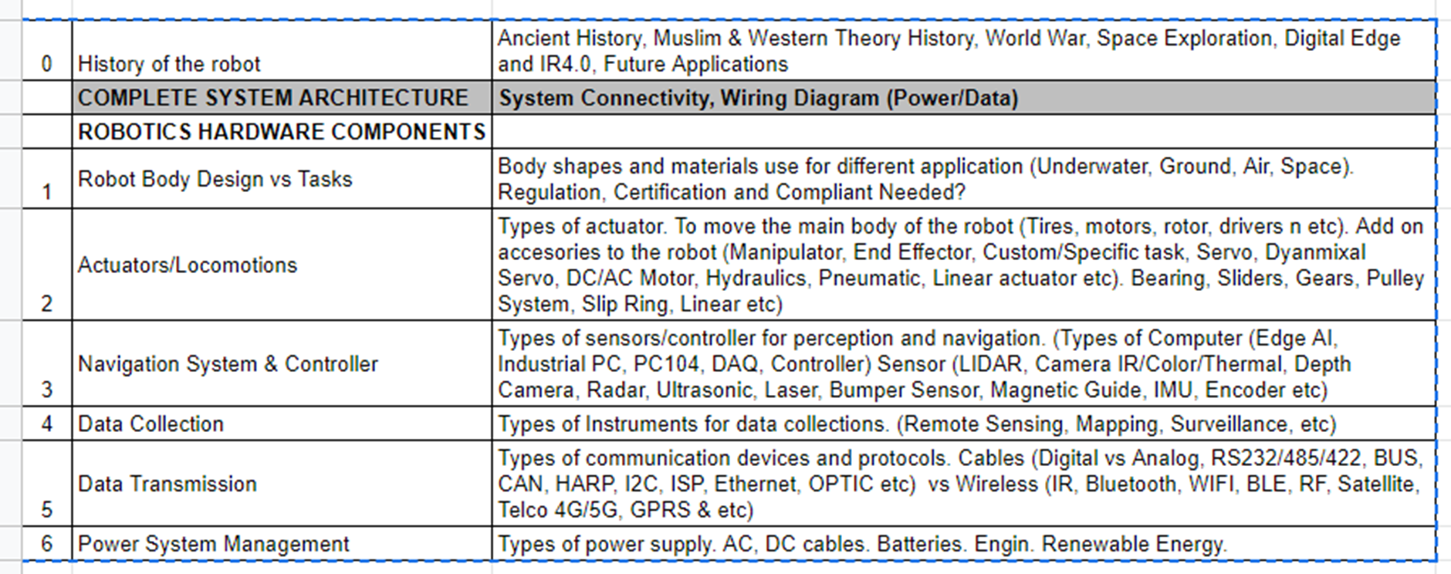
TABLE OF CONTENTS

Slide 4
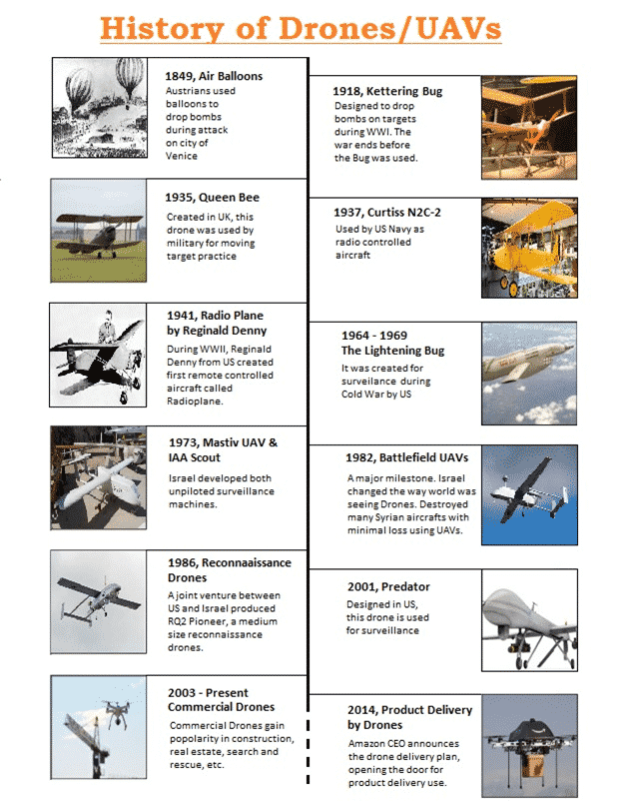

Slide 5
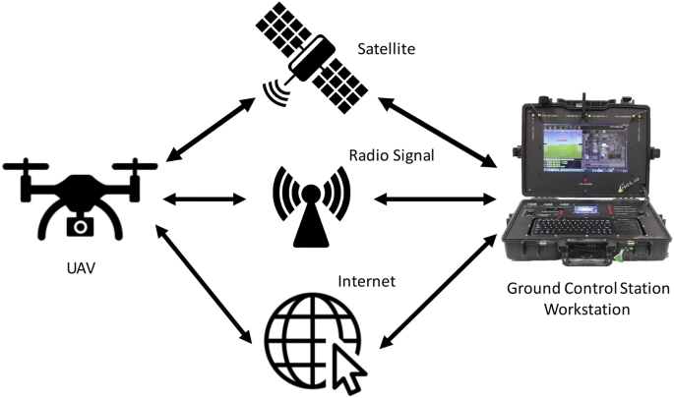
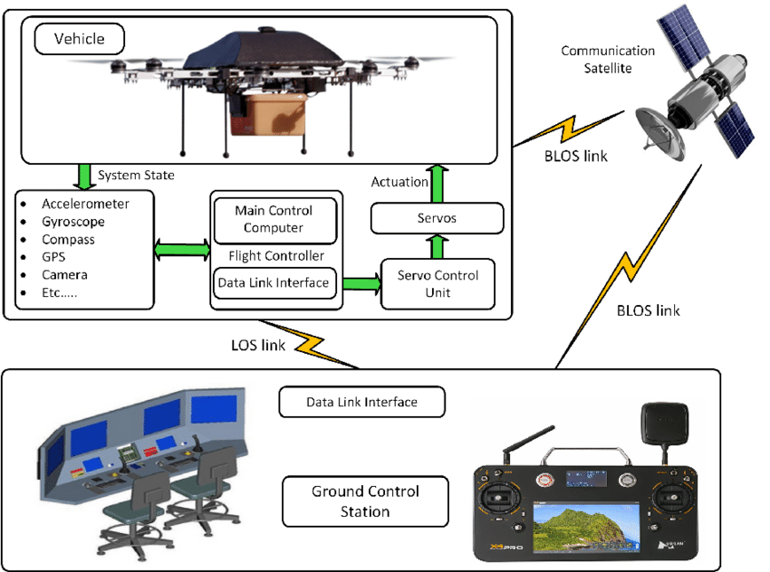
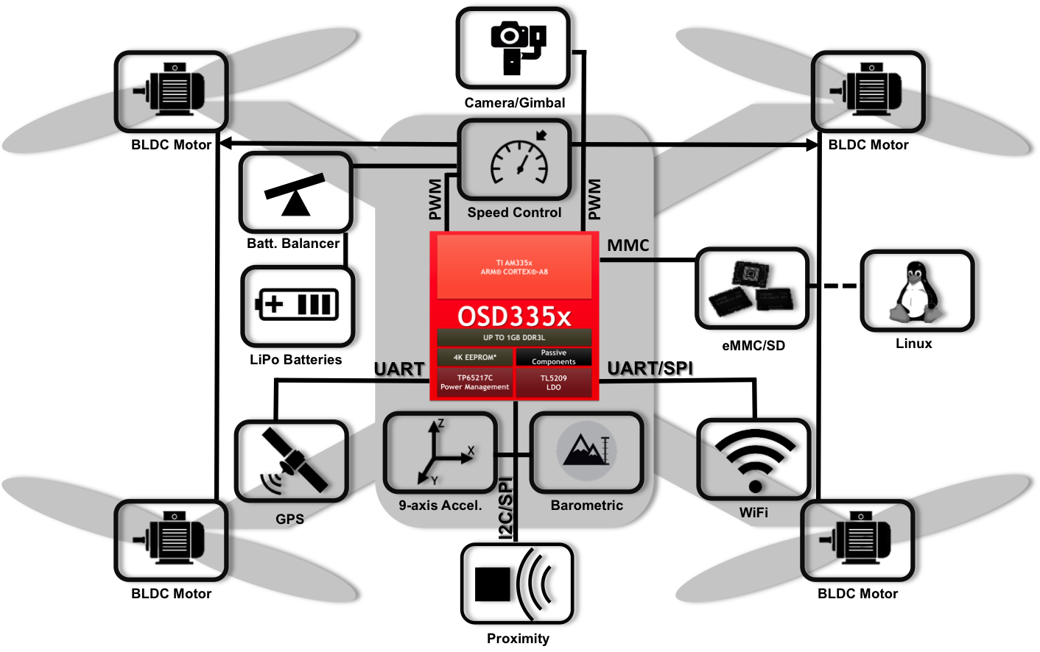
BASIC SYSTEM ARCHITECTURE FOR UAVs
Every UAVs uses the same components to operate which is flight controllers, propellers, IMU and communication system.

Slide 6
ROBOT DESIGN VS TASK

Slide 7
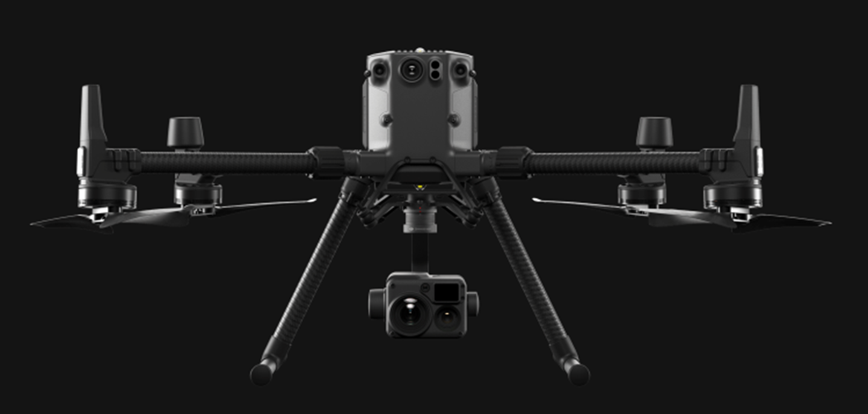
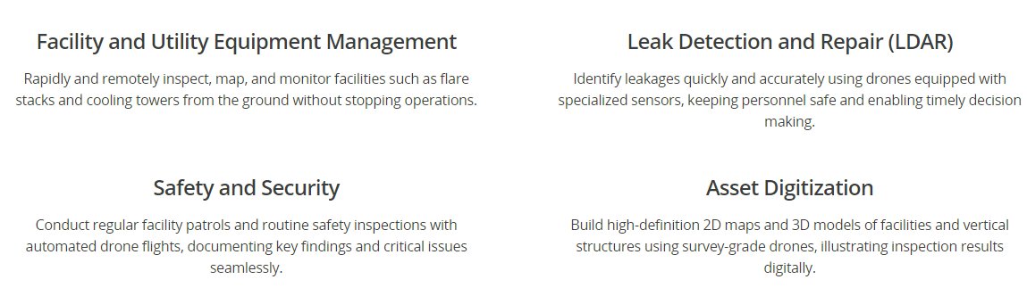
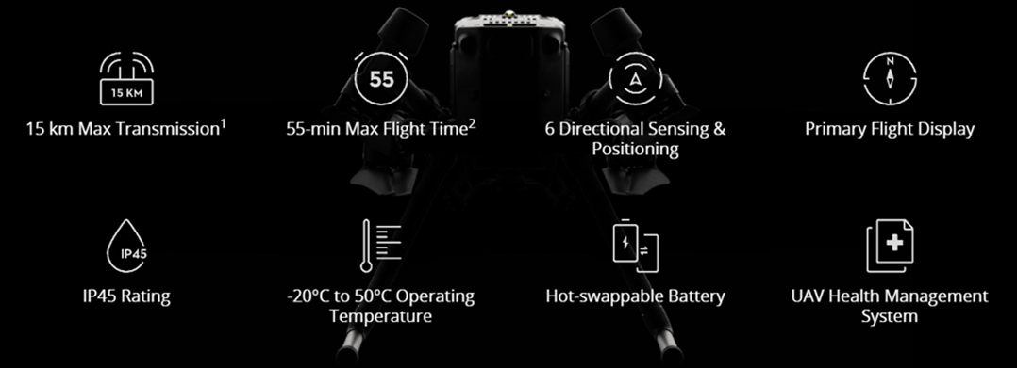
MATRICE 300 RTK
PRODUCTION AND REFINERY MANAGEMENT
SPECIFICATION

Slide 8
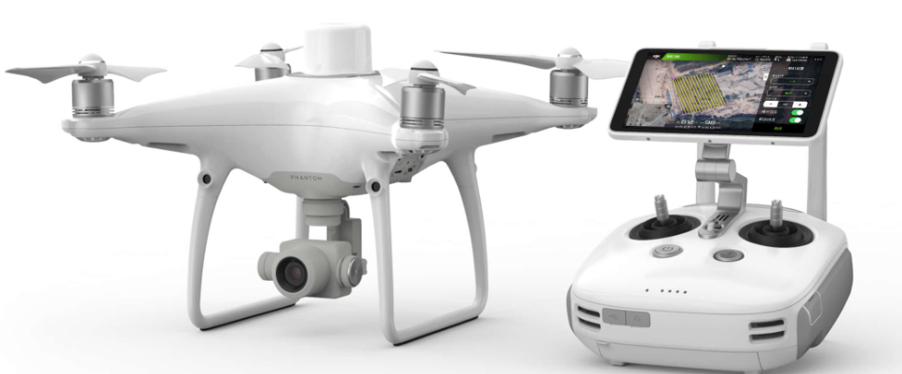
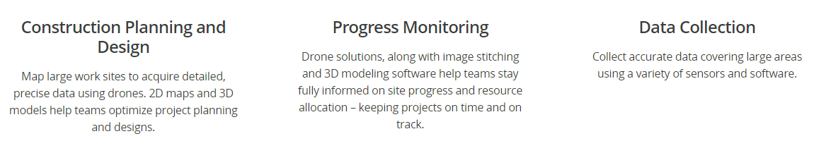
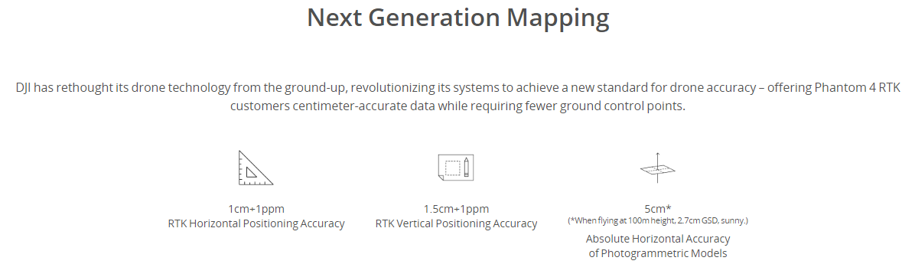
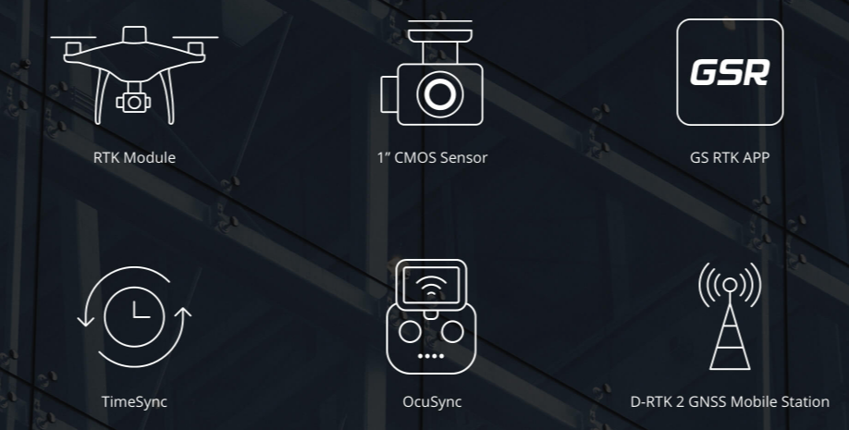
PIPELINE INTEGRITY INSPECTION
PHANTOM 4 RTK
SPECIFICATION

Slide 9
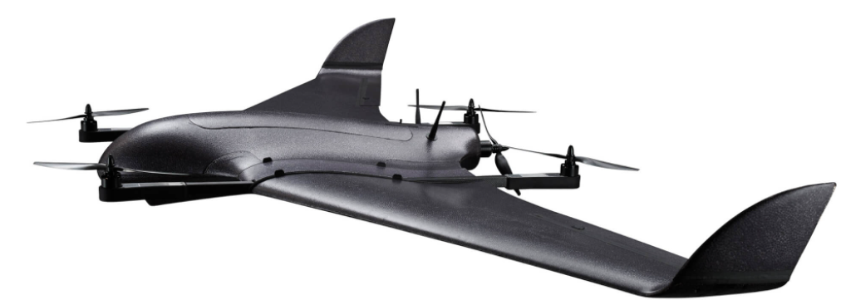
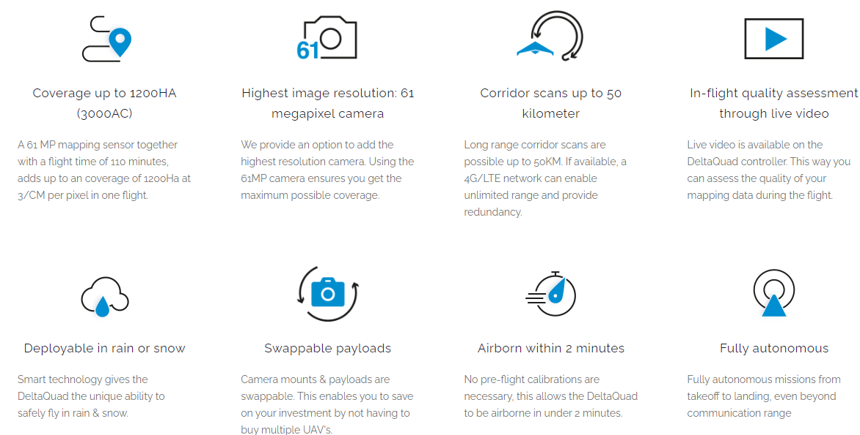
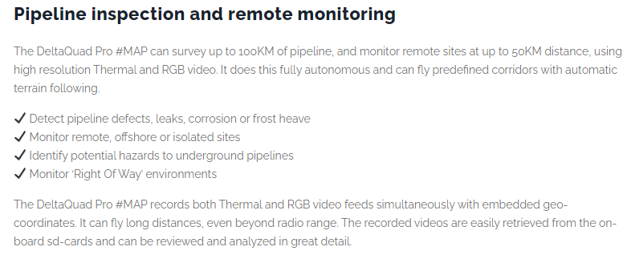
DELTAQUAD VTOL

Slide 10
ACTUATORS AND LOCOMOTION

Slide 11
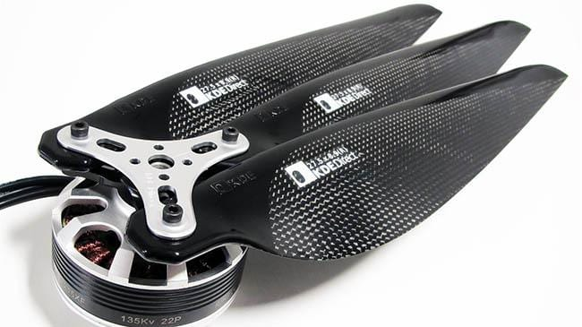
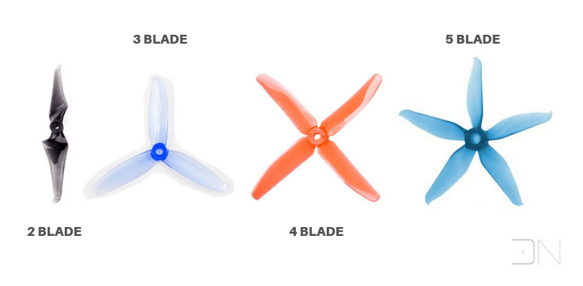
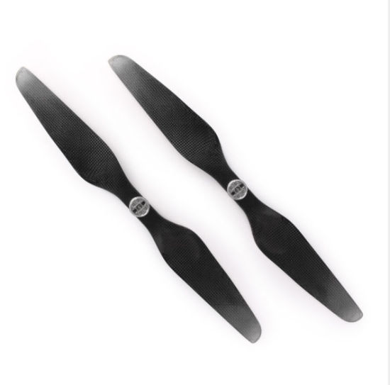
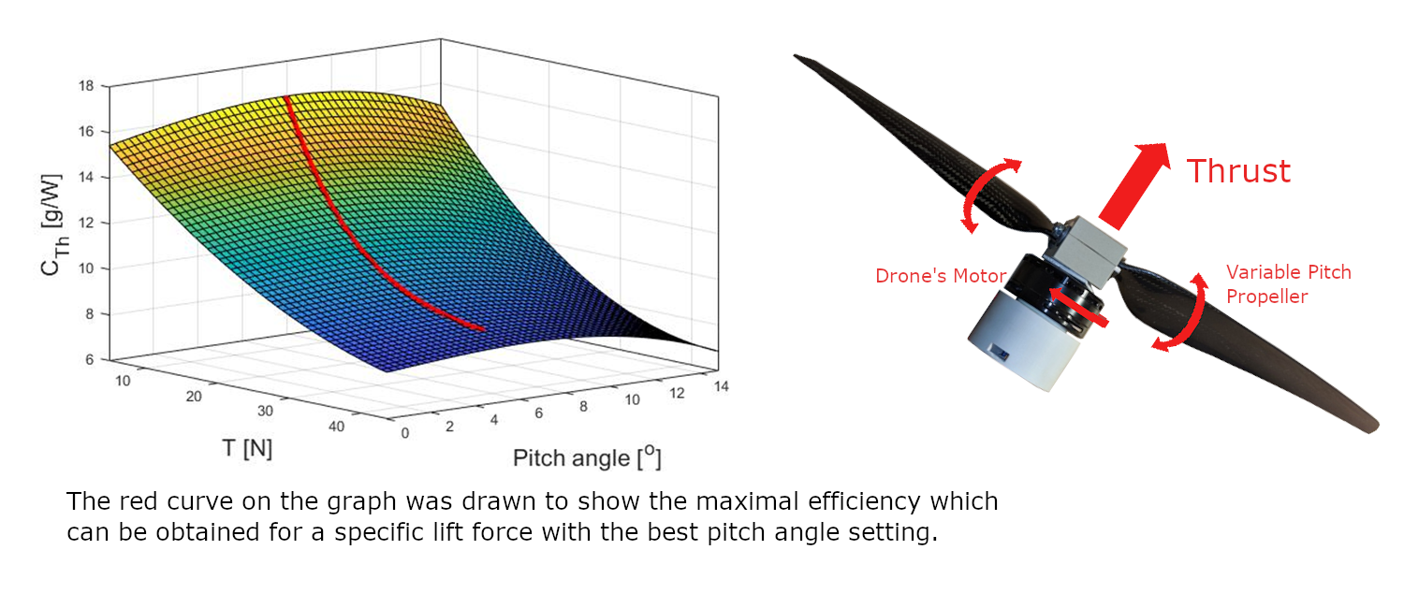
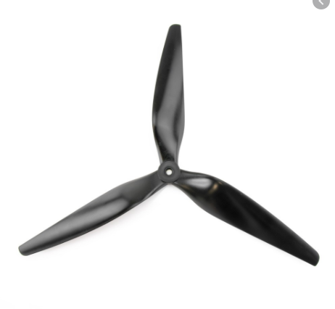
PROPELLER
Propellers are devices that transform rotary motion into linear thrust. Drone propellers provide lift for the aircraft by spinning and creating an airflow, which results in a pressure difference between the top and bottom surfaces of the propeller.

Slide 12
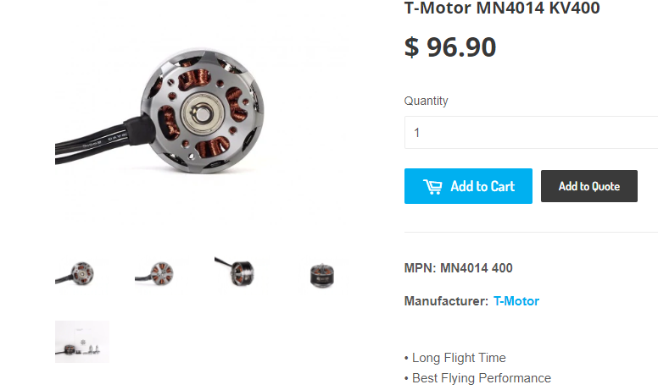
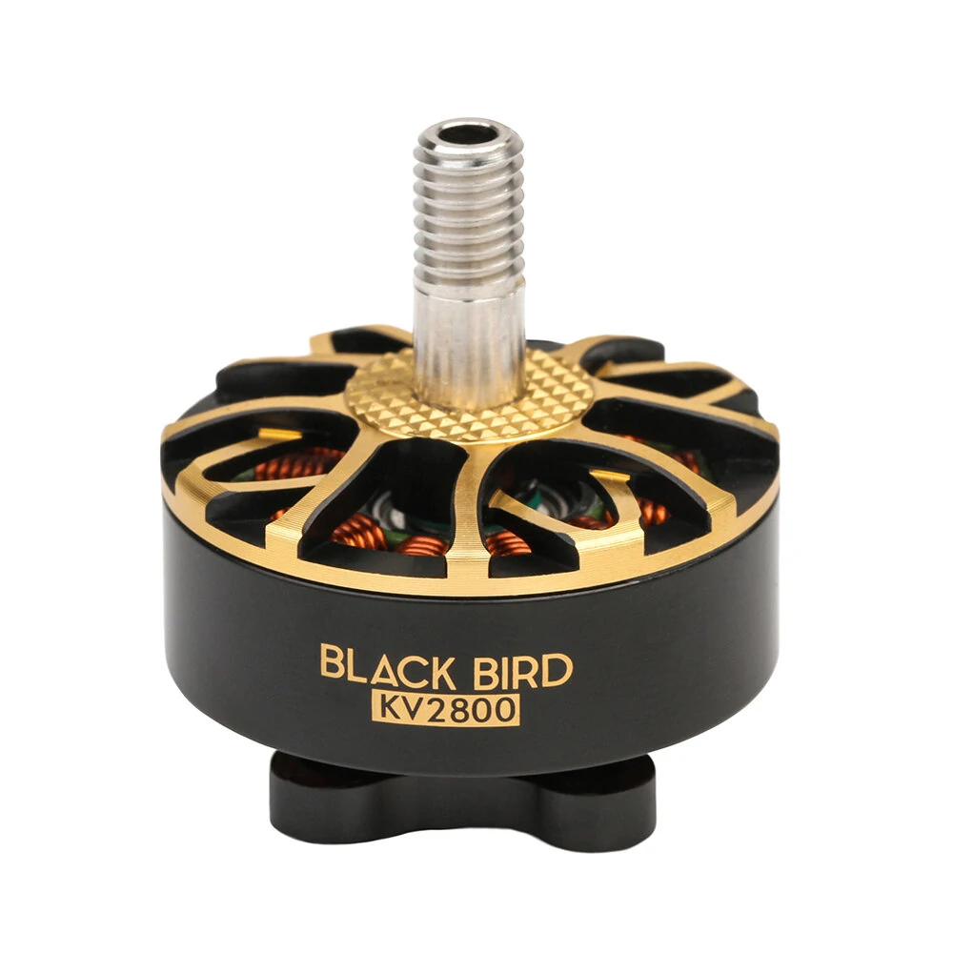
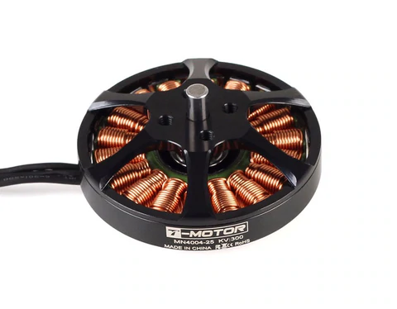
BRUSHLESS MOTOR
Brushless motors are better for drones because they have a much longer lifespan since they don't have brushes that can wear down. Brushless motors are also more powerful for their size, so they are used in more professional drones that require reliability and power.

Slide 13
NAVIGATION SYSTEM AND CONTROLLER

Slide 14
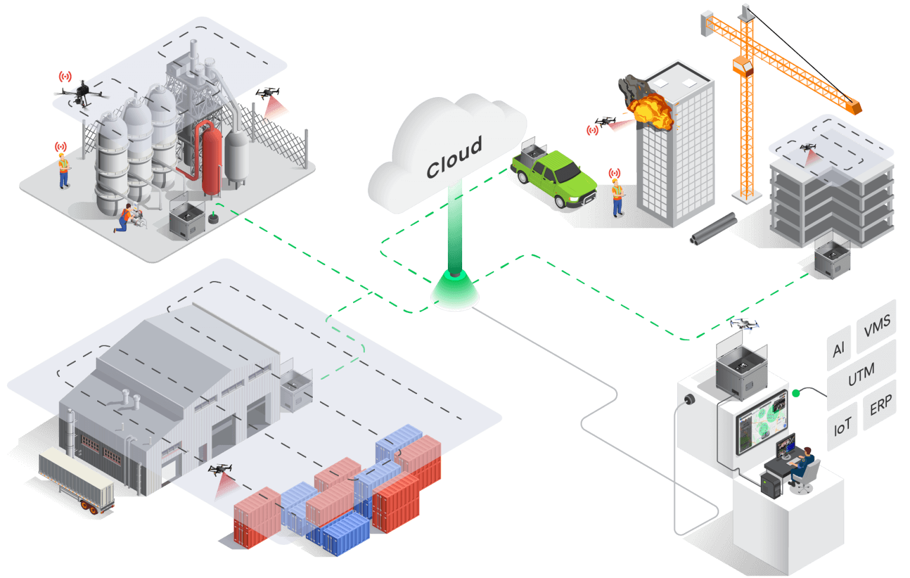
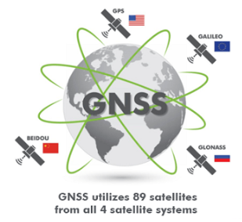
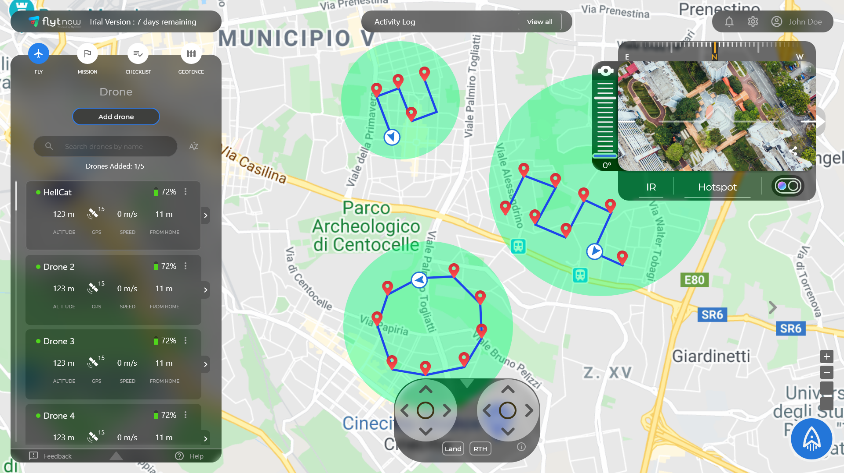
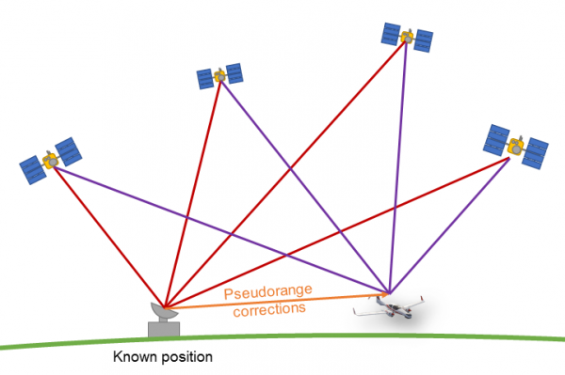
GNSS SYSTEM
FlytNow Cloud base service
Global navigation satellite system (GNSS) is a general term describing any satellite constellation that provides positioning, navigation, and timing (PNT) services on a global or regional basis.

Slide 15
DATA COLLECTION

Slide 16
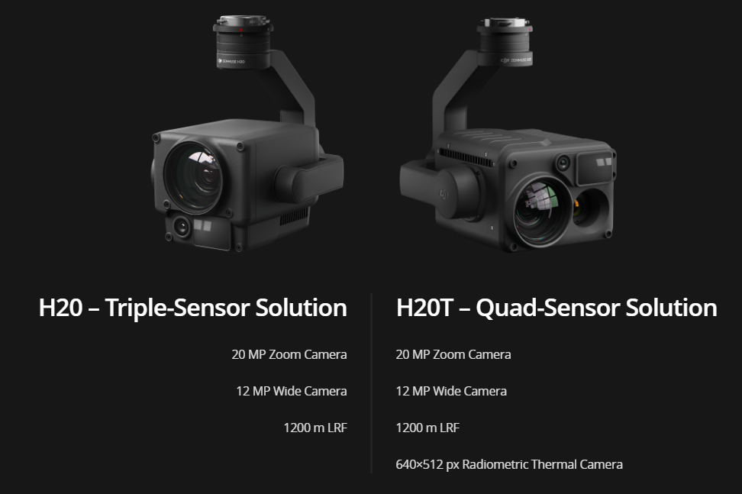

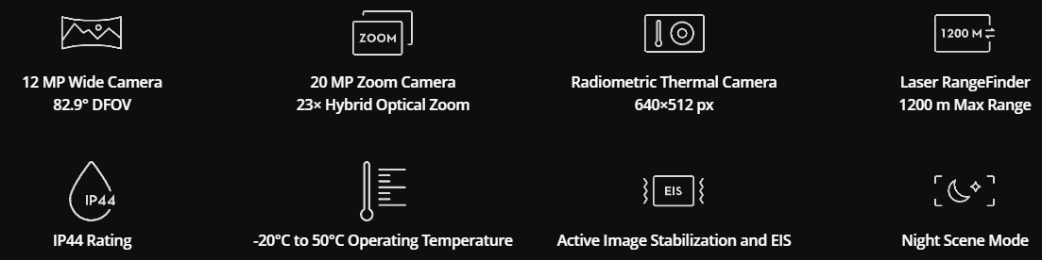
ZENMUSE H20 SERIES
Multi-sensor payloads that bring a whole new meaning to mission efficiency. The unique intelligence and integrated design provide unprecedented aerial imaging capabilities for a range of commercial drone applications.

Slide 17
DATA TRANSMISSION

Slide 18
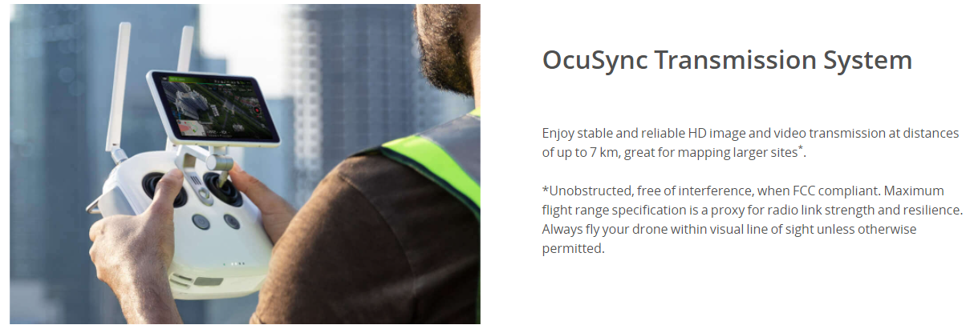
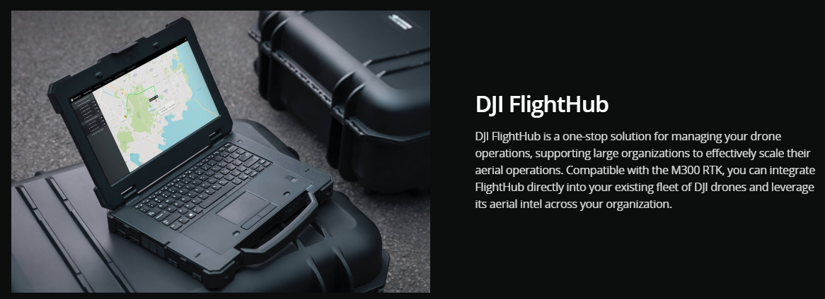
OcuSync Transmission System

Slide 19
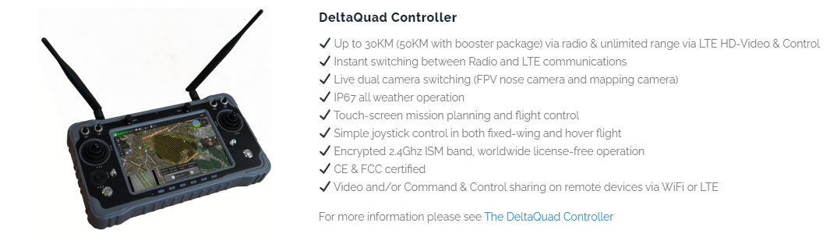
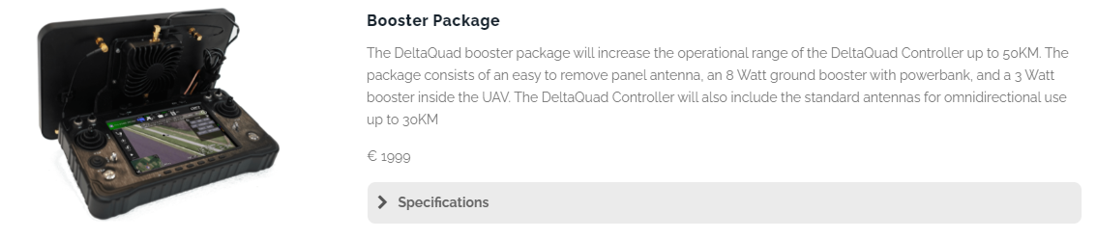
RADIO FREQUENCY

Slide 20
POWER MANAGEMENT

Slide 21
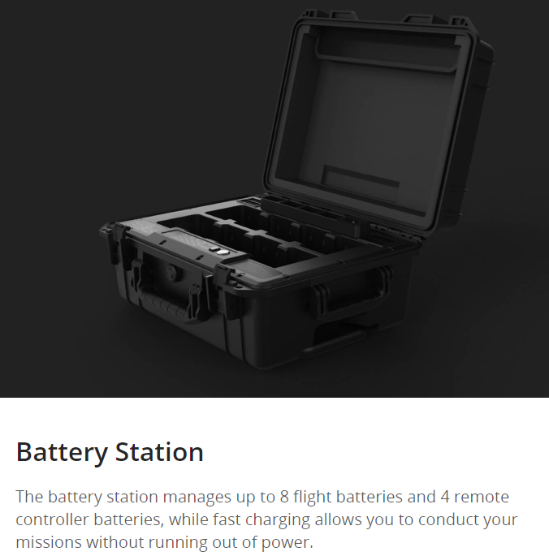
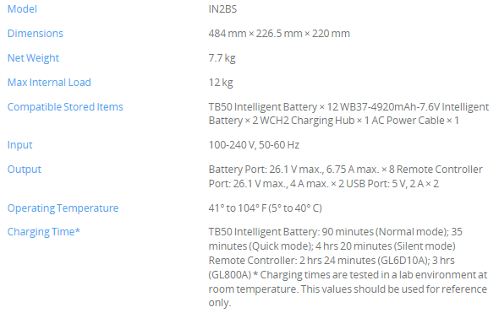
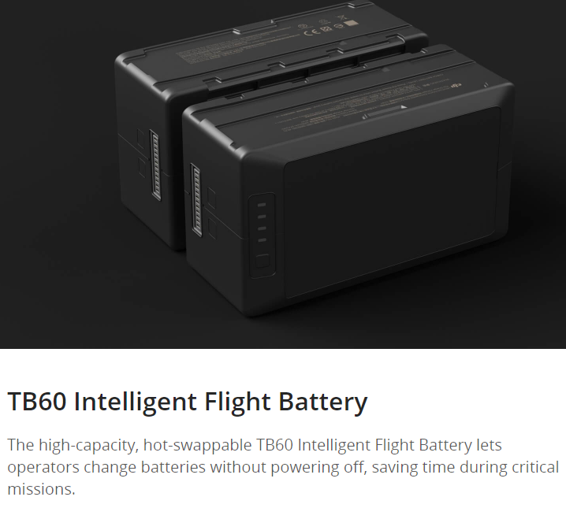
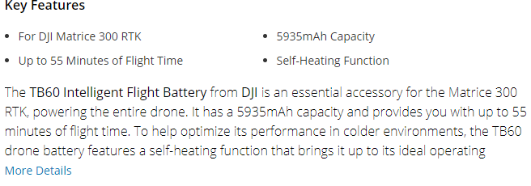

Slide 22
